Slide 1
Activity Based Costing

Slide 2
Learning Outcomes
Appraise the technique of activity based costing in a business.
Recognize the benefits of activity based costing over traditional costing.

Slide 3
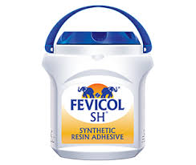
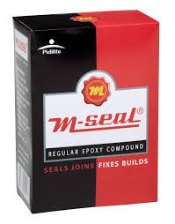
Activity Based Costing at Pidilite
Pidilite is manufacturing two industrial products in it’s factory area i.e. ‘Fevicol’ & ‘M – Seal’.
There are huge indirect costs (overheads) incurred while the production of these two items.
For each production run
1000 labor hours are used to produce ’Fevicol’ and 4000 labor hours are used to produce ‘M – Seal’.

Slide 4
Factory Layout of Pidilite
Fevicol (75% factory Area)
M - Seal (25% factory Area)
MACHINE
1
MACH
I
NE
2
MACH
I
NE
3
MACH
I
NE
4
MACH
I
NE
5
MA
CH
I
N
E
Notes:
Fevicol:
Employs more machines and a few workers to control such machines, Automated – One worker per machine
M – Seal:
Employs more workers (for assembly) and one machine
Labor Intensive

Slide 5
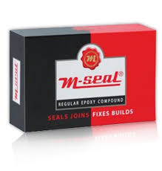
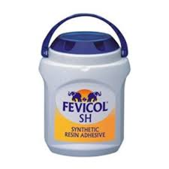
1. (Allocation of Factory Rent) – Traditional Costing
The company has to allocate ‘Factory Rent’ of $10,000 among two products.
In case, the allocation is made on the basis of labor hours, then,
Unfair Allocation
Allocation
Fevicol
10,000 * 1,000
5,000
M – Seal
10,000 * 4,000
5,000
$2000
$8000

Slide 6
1.1.(Allocation of Factory Rent) – Activity Based Costing
The company has to allocate ‘Factory Rent’ of $10,000 among two products.
Area occupied by ‘Fevicol’ is 6000 Sq. ft and by ‘M - Seal’ is 2000 Sq. ft.
Fair Allocation
Allocation
Fevicol
10,000 * 6,000
8,000
M – Seal
10,000 * 2,000
8,000
$7500
$2500

Slide 7
2. (Allocation of Factory Utilities) – Traditional Costing
The company has to allocate ‘Factory Electricity Bill’ of $25,000 among two products.
In case, the allocation is made on the basis of labor hours, then,
Unfair Allocation
Allocation
Fevicol
25,000 * 1,000
5,000
M – Seal
25,000 * 4,000
5,000
$5000
$20,000

Slide 8
2.1 (Allocation of Factory Utilities) – Activity Based Costing
The company has to allocate ‘Factory Utilities’ of $25,000 among two products.
‘Fevicol’ uses 30,000 units of electricity and ‘M – Seal’ uses 5,000 electricity units.
Fair Allocation
Allocation
Fevicol
25,000 * 30,000
35,000
M – Seal
25,000 * 5,000
35,000
$21500
$3571

Slide 9

Poll
Louis Phillippe is engaged in manufacturing of different apparels.
In the process of manufacturing, the company incurs different types of indirect costs (overheads).
The most appropriate manner of allocation of such ‘overheads’ shall be on the basis of:
Direct labor hours
Direct machine hours
Activity based costing
All of the above

Slide 10
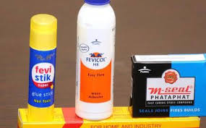
What Pidilite is doing?
Activity Based Costing
Identifies the ‘activities’ necessary to make a product
Focus on ‘activities’ and costs of activities
Assigns cost to each activity

Slide 11
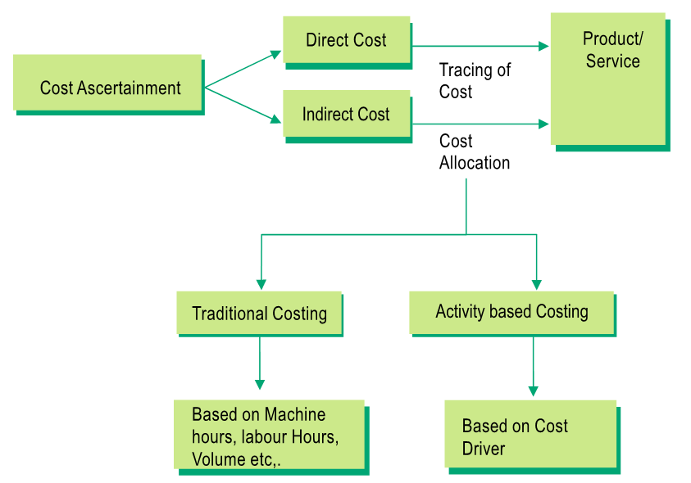
Traditional Costing Vs. ABC

Slide 12
Cost Driver
The direct cause of a cost and its effect is on the total cost incurred.
The number of units consumed determines the total bill for electricity.
In such a scenario, the number of units of electricity consumed is a cost driver.

Slide 13
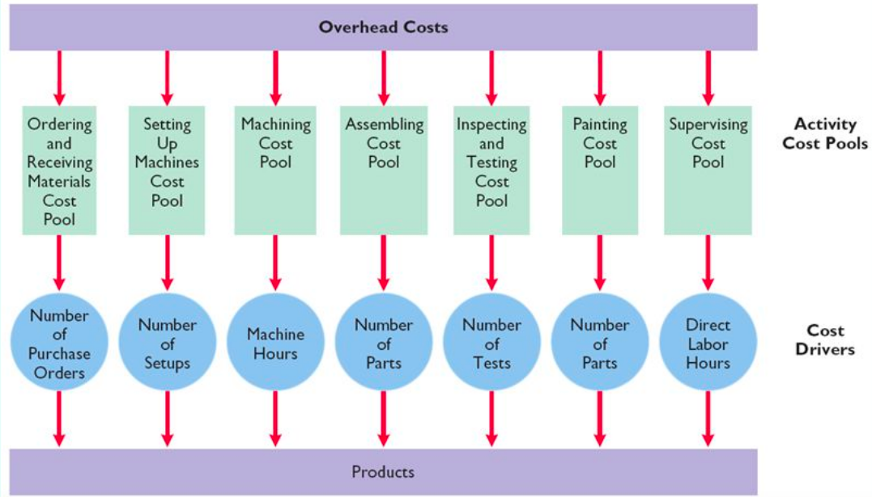
Activity Cost Pools & Cost Drivers in ABC

Slide 14
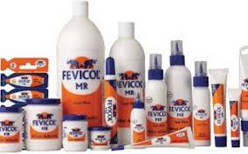
Poll
Pidilite has the total purchase requisition cost for Rs. 150,000. This is one of the important ‘activity’ while doing the production of ‘Fevicol’.
Identify which of the following will serve as the most appropriate ‘cost driver’ for this activity?
Number of machine set – ups
Number of times orders placed
Direct labor hours
Number of customers served
Notes:
b

Slide 15
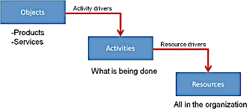
Activity Based Costing of Pidilite
Pidilite prepares the ‘catalog’ to be distributed to the customers.
These ‘catalogs’ highlights the usage and benefits of using ‘Pidilite’ products.
Preparation of catalog requires office space, printing and labor
Catalog Preparation → ‘Activity’
Number of Customers served→ ‘Cost drivers’
Labor, Office Space, Printing → ‘Resources’

Slide 16
Steps in Activity Based Costing
Identify Activities
Identify Cost driver
Compute activity based overhead rate
Assign overhead costs to product

Slide 17
Step 1: Identification and Estimation of Indirect Costs
Activity | Costs for Activity | Total Activity Cost Pool
Machine Set up | Indirect labor to set up machines, Oiling, Greasing | $10,000
Machine Handling | Forklifts, Gas, Operators Wages | $15,000
Fabricating Parts | Machine lease payments, electricity, repairs | $30,000
Inspection | Testing equipment, Inspection labor | $5000
Packaging | Packaging products | $5000
Total |  | $65,000

Slide 18
Step 2: Selection of Allocation Base (for each activity)
Activity | Allocation Base (Cost Driver) | Total Activity Cost Pool | Total estimated amount of allocation base
Machine Set up | Number of Machine Set ups | $10,000 | 8000 set ups
Machine Handling | Number of Parts moved | $15,000 | 400,000 parts
Fabricating Parts | Machine Hours | $30,000 | 12,000 machine hours
Inspection | Number of inspections | $5000 | 34,000 Inspections
Packaging | Cubic Feet packaged | $5000 | 400,000 Cubic feet
Total |  | $65,000

Slide 19
Step 3: Compute the Cost Allocation Base (for each activity)
Activity | Allocation Base (Cost Driver) | Total Activity Cost Pool | Total estimated amount of allocation base
Machine Set up | Number of Machine Set ups | $10,000 | =10,000/8000 = Rs. 1.25 per set - up
Machine Handling | Number of Parts moved | $15,000 | =15,000/400,000 =Rs. 0.50 per part
Fabricating Parts | Machine Hours | $30,000 | =30,000/12,000 = Rs. 24/machine hour
Inspection | Number of inspections | $5000 | =5,000/34,000 = Rs. 0.14 per inspection
Packaging | Cubic Feet packaged | $5000 | =5,000/400,000 = Rs. 0.01 per cubic feet
Total |  | $65,000

Slide 20
Step 4: Assign Overhead costs to product
Activity | Allocation Cost Allocation rate | Actual use of Activity Allocation Base | Total estimated amount of allocation base
Machine Set up | Rs. 1.25 per set - up | 2 set – ups | Rs. 2.5
Machine Handling | Rs. 0.50 per part | 20 parts | Rs. 4
Fabricating Parts | Rs. 24/machine hour | 1 machine hour | Rs. 24
Inspection | Rs. 0.14 per inspection | 3 inspections | Rs. 0.42
Packaging | Rs. 0.01 per cubic feet | 52 cubic feet | Rs. 0.52
Total |  | $65,000 | Rs. 31.44

Slide 21
Poll
In Activity Based Costing, the overhead costs are assigned to each product based on ______
the proportion of that product’s use of the cost driver
a predetermined overhead rate for a single cost driver
price of the product
machine hours per product

